Slide 1
INEFFECTIVE ASSISTANCE OF COUNSEL
Presented by:
Gary A. Udashen
Udashen | Anton
2311 Cedar Springs Rd., Suite 250
Dallas, Texas 75201
214-468-8100
214-468-8104 fax
gau@udashenanton.com
Board President, Innocence Project of Texas

Slide 2
WE ALL MAKE MISTAKES

Slide 3
INEFFECTIVE ASSISTANCE OF COUNSEL
Strickland v. Washington, 466 U.S. 668 (1984), test requires Applicant to show:
1. Counsel’s performance was deficient. Requires showing that counsel made errors so serious that counsel was not functioning as the counsel guaranteed by the Sixth Amendment.
2. The deficient performance prejudiced the defendant.

Slide 4
DEFICIENT PERFORMANCE
An appellate court “must indulge a strong presumption that counsel’s conduct [fell] within the wide range of reasonable professional assistance; that is, the [appellant] must overcome the presumption that under the circumstances, the challenged action might be considered sound trial strategy.”
Strickland, 466 U.S. at 689

Slide 5
DEFICIENT PERFORMANCE
“In the absence of evidence of counsel’s reasons for challenged conduct, an appellate court ‘commonly will assume a strategic motivation if any can possibly be imagined and will not conclude the challenged conduct constituted deficient performance unless the conduct was so outrageous that no competent attorney would have engaged in it.”
Garcia v. State, 57 S.W.3d 436
(Tex. Crim. App. 2001)

Slide 6
TRIAL COUNSEL’S REASONS
Record must show why counsel took the actions that constitute ineffective assistance. Thompson v. State, 9 S.W.3d 808 (Tex. Crim. App. 1999)
Trial counsel must provide affidavit or testimony.

Slide 7
TRIAL COUNSEL’S REASONS
“Under our system of justice, the criminal defendant is entitled to an opportunity to explain himself and present evidence on his behalf. His counsel should ordinarily be accorded an opportunity to explain her actions before being condemned as unprofessional and incompetent.”
Bone v. State, 77 S.W.3d 828, 836
(Tex. Crim. App. 2002)

Slide 8
PREJUDICE
Purpose of Strickland test is to judge whether counsel’s conduct so compromised the proper functioning of the adversarial process that the trial cannot be said to have produced a reliable result.
Thompson v. State, 9 S.W.3d 808
(Tex. Crim. App. 1999)

Slide 9
TOTALITY OF REPRESENTATION
Appellate court looks to the totality of the representation and the particular circumstances of each case in evaluating the effectiveness of counsel.
Thompson, 9 S.W.3d at 813
It is possible that a single egregious error of omission or commission by counsel constitutes ineffective assistance.
Thompson, 9 S.W.3d 813

Slide 10
WHEN TO RAISE ISSUE
Ineffective Assistance of Counsel may (should) be raised for first time on a writ. Ex Parte Torres, 943 S.W.2d 469 (Tex. Crim. App. 1997).
Trial record is rarely sufficient to show ineffective assistance.

Slide 11
GUILTY PLEAS
Must show that but for counsel’s errors defendant would not have entered a guilty plea. Hill v. Lockhart, 474 U.S. 52 (1985)

Slide 12
PLEA BARGAINING
Strickland test applies to plea bargaining stage of trial. Deficient advice concerning plea bargain constitutes ineffective assistance. Defendant must show that he would have accepted the offer, the state would not have withdrawn it and the trial court would have accepted it.
Lafler v. Cooper, 566 U. S. 156 (2012)
Missouri v. Frye, 566 U.S. 134 (2012)
Ex parte Argent, 393 S.W.3d 781
(Tex. Crim. App. 2013)

Slide 13
PLEA BARGAINING
Counsel ineffective for failure to properly advise defendant who was entering guilty plea whether state sentence would run concurrent with his federal sentence.
Ex parte Moody, 991 S.W.2d 856
(Tex. Crim. App. 1999)

Slide 14
PLEA BARGAINING
Failure to advise defendant prior to defendant’s entry of guilty plea that he had a viable legal defense that he did not perform an overt act needed to support his conviction constitutes ineffective assistance.
State v. Diaz-Bonilla, 495 S.W.3d 45
(Tex. App. – Houston [14th Dist.] 2016, pet.ref’d)

Slide 15
INCORRECT ADVICE ON PAROLE ELIGIBILITY
Counsel’s misinformation to defendant as to his parole eligibility constituted deficient performance.
Ex parte Moussazadeh, 361 S.W.3d 684
(Tex. Crim. App. 2012)

Slide 16
IMMIGRATION CONSEQUENCES
Failure to advise defendant of deportation consequences of conviction is ineffective assistance.
Padilla v. Kentucky, 559 U.S. 356 (2010)
Prejudice shown from counsel’s erroneous advice that guilty plea would not result in deportation when applicant shows he would not have pled guilty had he known he would be deported.
Jae Lee v. United States, 137 S.Ct. 1958 (2017)

Slide 17
DUTY TO INVESTIGATE
STRATEGIC DECISIONS ARE BASED ON INVESTIGATION
The Supreme Court has made clear that “strategic choices made after thorough investigation of law and facts relevant to plausible options are virtually unchallengeable.”
Strickland, 466 U.S. at 690-91
But when choices are made after less than complete investigation, they are reasonable only “to the extent that reasonable professional judgments support the limitations on investigation.” Strickland, 466 U.S. at 691.
And decisions made out of inattention are not strategic and afforded no deference at all.
Wiggins v. Smith, 539 U.S. 510, 526 (2003)

Slide 18
FAILURE TO INVESTIGATE
Failure of trial counsel to investigate information that someone else committed the crime is ineffective.
Ex Parte Amezquita, 223 S.W.3d 363
(Tex. Crim. App. 2006)

Slide 19
FAILURE TO INVESTIGATE
Attorney found ineffective for failing to investigate facts of robbery case, telling his client that a videotape existed of him committing the offense when no such tape existed, thereby causing defendant to plead guilty to robbery even though he had no memory of committing the offense because he suffered from alcoholic blackouts.
Melton v. State, 987 S.W.2d 72
(Tex. App. – Dallas 1998, no. pet.)

Slide 20
IGNORANCE OF THE LAW
Counsel ineffective for lack of awareness of case holding that, on charge for possession of or attempt to possess controlled substance through use of fraudulent prescription form, State had to prove that defendant presented “fraudulent” form, not just that defendant committed “fraud” by interlineating upon otherwise legitimate form.
Ex Parte Lewis, 537 S.W.3d 917
(Tex. Crim. App. 2017)

Slide 21
INEFFECTIVE ASSISTANCE DURING TRIAL
Attorneys rendered ineffective assistance by failing to investigate and present mitigating evidence of defendant being abused as a child in capital murder case.
Ex parte Gonzales, 204 S.W.3d 391
(Tex. Crim. App. 2006)
Trial counsel’s failure to impeach witness with his inconsistent statements, made when he told police that he saw shooter’s face but could not make it out, constituted deficient performance.
Ex parte Saenz, 491 S.W.3d 819
(Tex. Crim. App. 2016)

Slide 22
INEFFECTIVE ASSISTANCE DURING TRIAL
Failure to object to evidence of polygraph test administered to witness found to be ineffective.
Ex parte Bryant, 448 S.W.3d 29
(Tex. Crim. App. 2014)
Counsel ineffective where he failed to participate in trial after motion for continuance was denied.
Cannon v. State, 252 S.W.3d 342
(Tex. Crim. App. 2008)

Slide 23
INEFFECTIVE ASSISTANCE DURING TRIAL
Failure of counsel to determine that a prior conviction alleged to enhance misdemeanor DWI to felony did not belong to the defendant.
Ex parte Harrington, 310 S.W.3d 452
(Tex. Crim. App. 2010)
Counsel ineffective for failing to request an interpreter for the defendant who was deaf.
Ex parte Cockrell, 424 S.W.3d 543
(Tex. Crim. App. 2014)

Slide 24
INEFFECTIVE ASSISTANCE DURING TRIAL
Failure to request limiting instruction.
Ex parte Varelas, 45 S.W.3d 627 (Tex. Crim. App. 2001)
Failure to file application for probation.
Ex parte Welch, 981 S.W.2d 183 (Tex. Crim. App. 1998)
Failure to request accomplice witness instruction when case based entirely on accomplice testimony. Ex parte Zepeda, 819 S.W.2d 874 (Tex. Crim. App. 1991)

Slide 25
INEFFECTIVE ASSISTANCE DURING TRIAL
A defendant has the right under Sixth Amendment to insist that counsel refrain from admitting guilt during the guilt-phase of a capital murder trial, even when counsel’s view is that confessing guilt offers the defendant the best chance to avoid the death penalty.
McCoy v. Louisiana,
138 S.Ct. 1500 (2018)

Slide 26
INEFFECTIVE ASSISTANCE DURING TRIAL
Counsel ineffective by failing to object to instruction that defendant was guilty of injury to child if he intentionally and knowingly engaged in conduct causing injury; law was clearly established that injury to child required proof that defendant intended result of offense.
Banks v. State,
819 S.W.2d 676
(Tex. App. – San Antonio 1991, pet. ref’d)

Slide 27
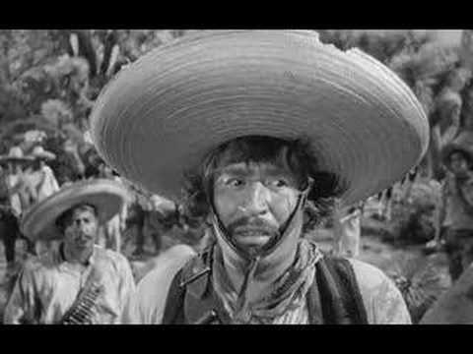
WE DON’T NEED NO STINKING EXPERTS

Slide 28
FAILURE TO OBTAIN EXPERT ASSISTANCE
Retained counsel performed deficiently in limiting, for economic reasons, his investigation of medical evidence before advising client to plead guilty. Ex parte Briggs, 187 S.W.3d 458 (Tex. Crim. App. 2005)

Slide 29
FAILURE TO OBTAIN EXPERT ASSISTANCE
Failure to hire DNA expert in sexual assault and kidnapping prosecution amounted to deficient performance, although counsel consulted other attorneys, doing so was insufficient investigation in this case given the fact that counsel still lacked much understanding of DNA science, and expert testimony likely would have given a boost to the defense beyond what could have been accomplished through cross-examination. (no prejudice found)
Ex parte Napper, 322 S.W.3d 202
(Tex. Crim. App. 2010)

Slide 30
FAILURE TO CALL EXPERT
Defense team’s failure to present physician’s expert testimony regarding sodium intoxication constituted ineffective assistance of counsel.
Ex parte Overton,
444 S.W.3d 632
(Tex. Crim. App. 2014)

Slide 31
FAILURE TO OBTAIN EXPERT ASSISTANCE
Defense counsel ineffective for failure to request additional funds to replace an inadequate expert in firearms and toolmark analysis.
Hinton v. Alabama,
571 U.S. 263 (2014)

Slide 32
FAILURE TO OBTAIN EXPERT ASSISTANCE
Ineffective assistance based on counsel’s failure to consult with an expert concerning sexual abuse and proper methods of interviewing children
Wright v. State,
223 S.W.3d 36 (Tex. App. – Houston [14th Dist.] 2016, pet. ref’d)

Slide 33
FAILURE TO CALL EXPERT
TEXANS HATE THE IVY LEAGUE
Capital murder case
Issue of causation over death of fetuses
Defense expert available to contradict prosecution theory
Calling the doctor could have presented potential pitfalls for the defense. For instance, the Angelina County jurors might not have been especially receptive to an expert traveling halfway across the country- from Yale-to testify in their small-town, East-Texas courthouse.
No ineffective assistance
Ex parte Flores, 387 S.W.3d 626, 637
(Tex. Crim. App. 2012)

Slide 34
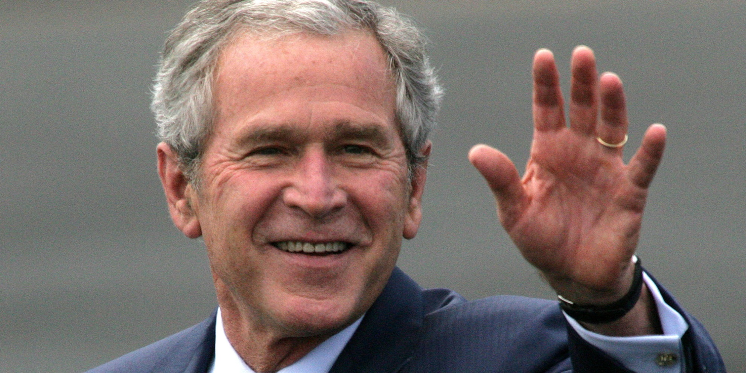
IVY LEAGUER

Slide 35
PUNISHMENT PHASE INEFFECTIVENESS
The sentencing process consists of weighing mitigating and aggravating factors, and making adjustments in the severity of the sentence consistent with this calculus.
Failure to contact or call to testify twenty character witnesses is ineffective assistance.
Milburn v. State, 15 S.W.3d 267
(Tex. App. – Houston [14th Dist.] 2000, pet. ref’d.)

Slide 36
PUNISHMENT PHASE INEFFECTIVENESS
Counsel ineffective for calling expert witness at sentencing phase of capital murder trial who testified that being black created an increased probability of future dangerousness.
Buck v. Davis, 137 S.Ct. 759 (2017)

Slide 37
PUNISHMENT PHASE INEFFECTIVENESS
Failure to object during punishment phase to testimony by DEA agent on dangers and societal costs of methamphetamine and prosecutor’s closing argument about “people” bringing in the drug to “poison” the county’s children constituted deficient performance.
Ex parte Lane, 303 S.W.3d 702
(Tex. Crim. App. 2009)

Slide 38
PUNISHMENT PHASE INEFFECTIVENESS
Failure of counsel to discover evidence showing that the defendant was not at the scene of a crime used as an extraneous offense at punishment phase constitutes ineffective assistance of counsel.
Ex parte Rogers, 369 S.W.3d 858
(Tex. Crim. App. 2012)

Slide 39
PUNISHMENT PHASE INEFFECTIVENESS
Trial counsel’s failure to investigate and discover defendant’s mental health history prejudiced defendant at penalty phase of trial; there was reasonable probability of less severe sentence; substantial mitigating evidence was available.
Lampkin v. State, 470 S.W.3d 876
(Tex. App. – Texarkana 2015, pet. ref’d)

Slide 40
INEFFECTIVENESS ON MOTION FOR NEW TRIAL
Rights to effective assistance applies at Motion for New Trial.
Cooks v. State, 240 S.W.3d 906
(Tex. Crim. App. 2007)
To prove harm, must present a “facially plausible” claim that could have been argued in Motion for New Trial but was not.
Cooks, 240 S.W.3d at 912

Slide 41
INEFFECTIVENESS ON APPEAL
To obtain relief in the form of a new direct appeal on a claim of ineffective assistance of appellate counsel, a habeas applicant must show that (1) counsel’s decision not to raise a particular point of error was objectively unreasonable, and (2) there is a reasonable probability that, but for counsel’s failure to raise that particular issue, he would have prevailed on appeal.
Ex parte Flores, 387 S.W.3d 626
(Tex. Crim. App. 2012)

Slide 42
INEFFECTIVENESS ON APPEAL
An attorney need not advance every argument, regardless of merit, urged by appellant, but if appellate counsel fails to raise a claim that has indisputable merit under well-settled law and would necessarily result in reversible error, appellate counsel is ineffective for failing to raise it.
Ex parte Flores, 387 S.W.3d 626
(Tex. Crim. App. 2012)

Slide 43
EGREGIOUS CONDUCT BY COUNSEL
Counsel had actual conflict of interest. Trial counsel was engaged in a coercive sexual relationship with Applicant; trial counsel had access to and control over Applicant’s case; trial counsel had a political, financial, and personal interest which colored his representation of Applicant. The Court finds that this actual conflict of interest violated Applicant’s Sixth Amendment rights.
Ex Parte Sanchez, No. WR-84,238-01,
2017 WL 3380147
(Tex. Crim. App. 2017)

Slide 44
