Slide 1
LEGAL ISSUES IN TEXAS INNOCENCE CASES
Presented by:
Gary A. Udashen
Sorrels, Udashen & Anton
2311 Cedar Springs Rd., Suite 250
Dallas, Texas 75201
214-468-8100
214-468-8104 fax
gau@sualaw.com

Slide 2
Cory Session of Fort Worth, center, wipes his eyes as Texas Gov. Rick Perry, right, and Texas state Senator Wendy Davis, left, bow their heads in prayer during a ceremony to unveil a Timothy Cole memorial in Lubbock, Wednesday, Sept. 17, 2014. Twenty-eight years to the day after Timothy Cole was falsely convicted of raping a Texas Tech student, Lubbock and state officials unveiled a statue honoring the U. S. Army veteran on a street corner not far from where the student was abducted. AP/Lubbock Avalanche-Journal

Slide 3
TIM COLE STATUE UNVEILING

Slide 4
TIM COLE STATUE UNVEILING

Slide 5
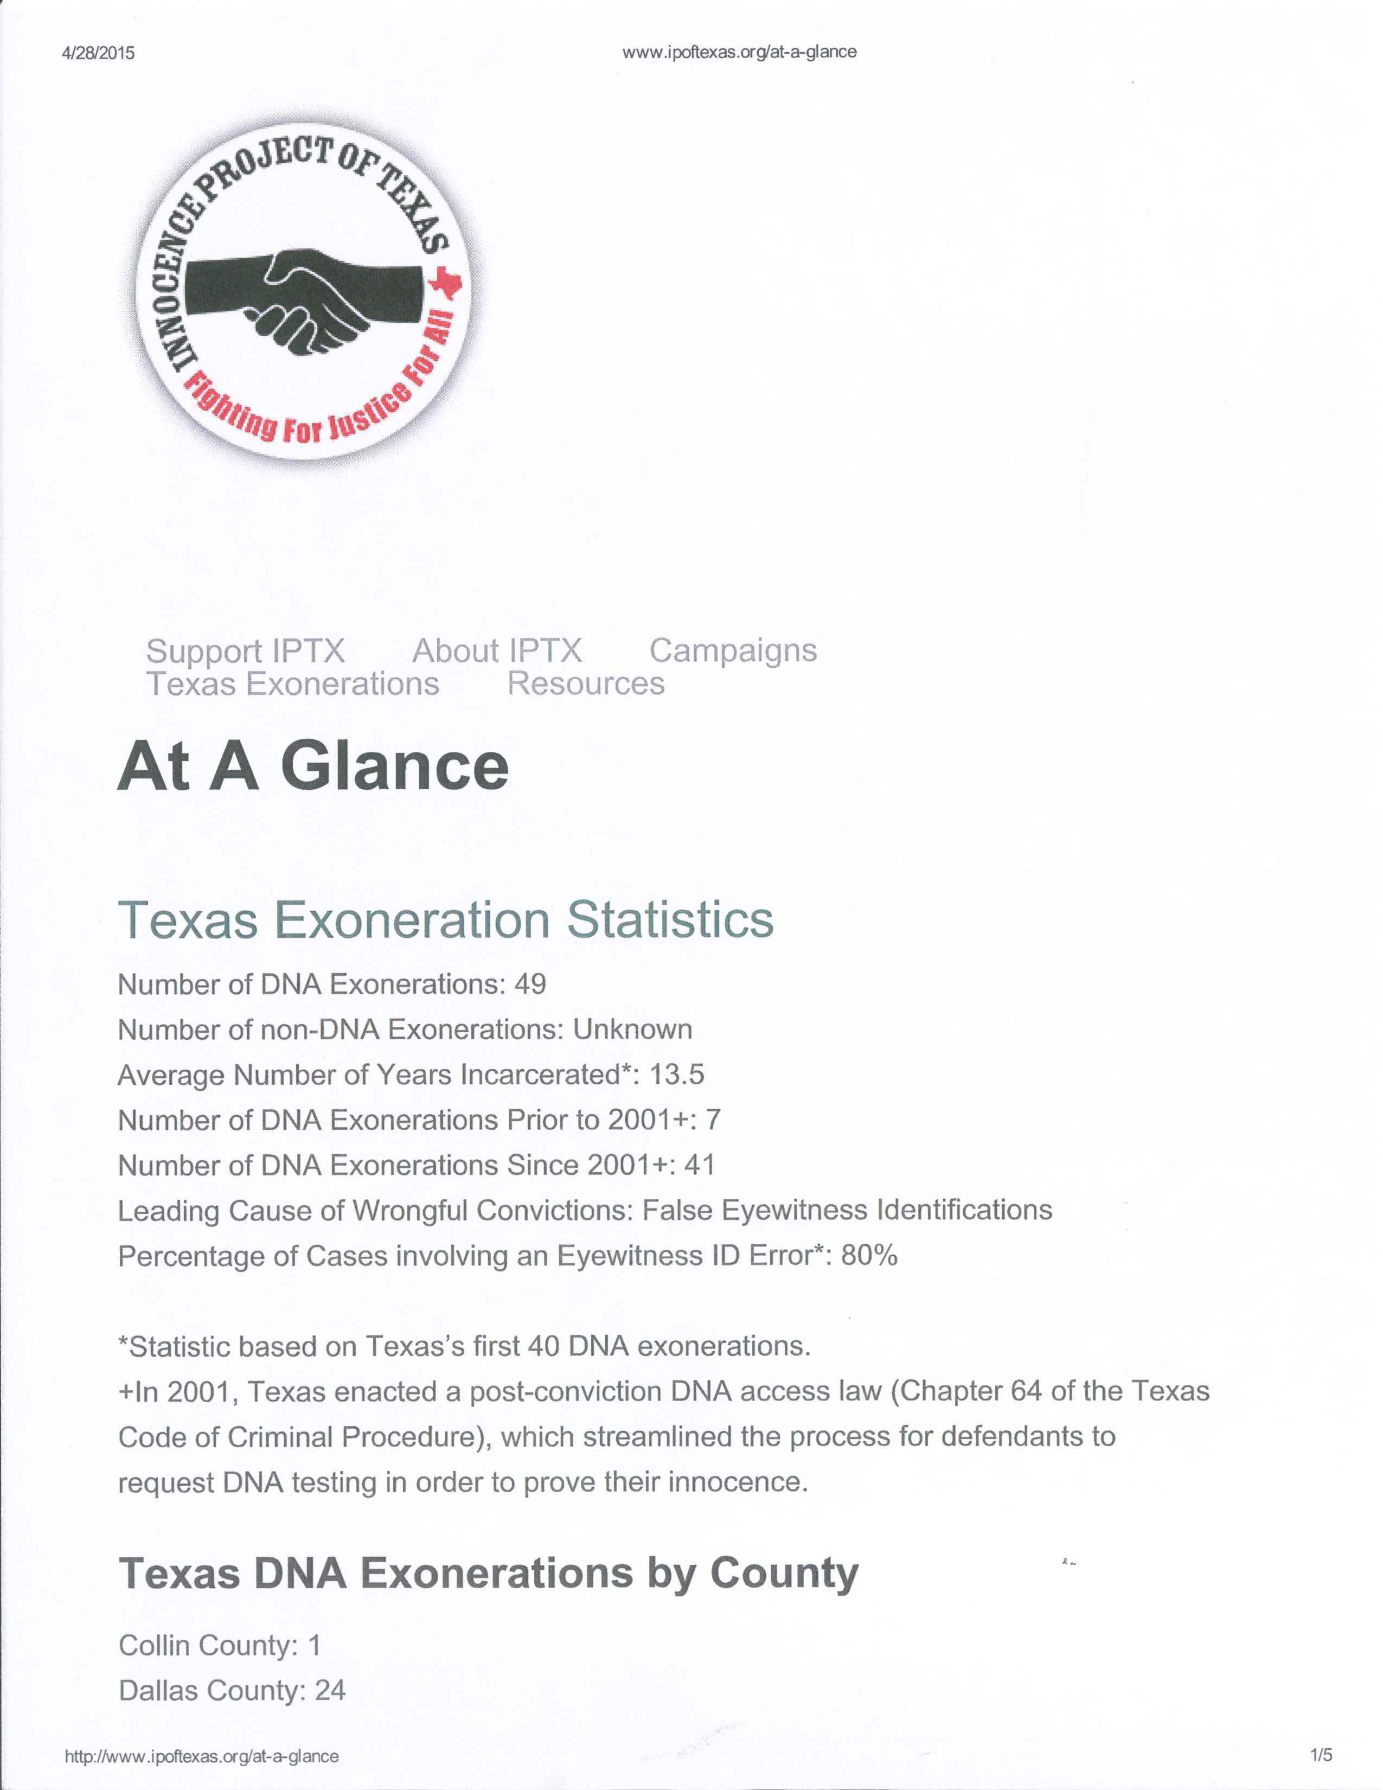

Slide 7
DNA Exonerations in Texas What We’ve Learned
Average Texas DNA exoneree spent more than 13 years incarcerated on their wrongful convictions.
Majority of DNA exonerations in Texas from Dallas County. Possible reasons:
Dallas County is a leader in preserving biological evidence
District Attorney’s Conviction Integrity Unit is proactively seeking to identify and correct wrongful convictions
More than 75% of Texas DNA exonerations based on faulty eyewitness identifications.
Other leading causes of wrongful convictions in Texas include prosecutorial misconduct, inadequate defense representation, forensic science misconduct, and false confessions.

Slide 9
TEXAS ACTUAL INNOCENCE STANDARD
Ex Parte Elizondo, 947 S.W.2d 202 (1996)
Applicant must show that newly discovered evidence of actual innocence unquestionably established innocence.

Slide 10
ACTUAL INNOCENCE STANDARD
Court must examine the new evidence in light of the evidence presented at trial
To grant relief court must believe that no rational juror would have convicted in light of the newly discovered evidence.

Slide 11
ACTUAL INNOCENCE STANDARD
Applies to:
DNA
Recantations
Other New Evidence

Slide 12
Ex Parte Brown, 205 S.W.3d 538 (2006)
Establishing a bare claim of actual innocence is a herculean task
Must make an exceedingly persuasive case of actual innocence

Slide 13
RECANTATIONS
Ex Parte Thompson, 153 S.W.3d 416 (2005)
Complainant, daughter of Applicant, provided affidavit and testimony stating that sexual abuse never occurred.
Ex Parte Tuley, 109 S.W.3d 388 (2002)
Actual innocence claims are not barred by guilty plea.

Slide 14
NEWLY DISCOVERED OR NEWLY AVAILABLE EVIDENCE:
Ex Parte Calderon, 309 S.W.3d 64 (2010)
Evidence of innocence must be newly discovered or newly available.

Slide 15
Ex Parte Navarijo, 433 S.W.3d 558 (2014)
Complainant’s recantation alone insufficient to prove actual innocence.

Slide 16
NON-RECANTATION ACTUAL INNOCENCE CASE
Defendant actually innocent of duty to register as a sex offender. Ex Parte Harbin, 297 S.W.3d 283 (2009)

Slide 17
SUPPRESSION OF EXCULPATORY EVIDENCE
Suppression by the prosecution of evidence favorable to an accused violates due process where the evidence is material either to guilt or to punishment, irrespective of the good faith or bad faith of the prosecution.
Brady v. Maryland
373 U.S. 83 (1963)

Slide 18
THREE PART TEST TO OBTAIN RELIEF BASED ON SUPPRESSION OF EXCULPATORY EVIDENCE
The prosecution withheld or suppressed evidence.
The evidence was favorable to the defense.
The evidence was material to either guilt or punishment.

Slide 19
MATERIALITY TEST
The materiality test is met and a new trial required if there is a reasonable probability that, had the evidence been disclosed to the defense, the result of the proceeding would have been different. This reasonable probability is defined as “a probability sufficient to undermine confidence in the outcome.”
United States v. Bagley,
473 U.S. 667 (1985)

Slide 20
Kyles v. Whitley, 514 U.S. 419 (1995)
State failed to disclose conflicting statements by witnesses
This evidence would have made a different result “reasonably probable”
Non-disclosure is Brady violation

Slide 21
Thomas v. State, 841 S.W.2d 399 (1992)
Duty to disclose favorable evidence attaches with or without a request for the evidence. When unsure of whether to disclose the evidence, the prosecutor should submit the evidence to the trial judge for his consideration.

Slide 22
Thomas v. State
Because Brady was aimed at ensuring that an accused receives a fair trial rather than punishing the prosecutor for failing to disclose favorable evidence, the prosecution’s obligation to disclose is not measured by the moral culpability, or the willfulness, of the prosecutor. In Brady cases the good or bad faith of the State is irrelevant for due process purposes.

Slide 23
Ex Parte Richardson, 70 S.W.3d 865 (2002)
Because we agree that the credibility of the State’s only eyewitness, Anita Hanson, was crucial issue in applicant’s trial, we conclude that the State had an affirmative constitutional duty under Brady v. Maryland to disclose material evidence that impeached her testimony.

Slide 24
CHANGING SCIENTIFIC EVIDENCE
Ex parte Robbins, 360 S.W.3d 446 (2011), cert. denied May 14, 2012)
QUESTION: HOW SHOULD COURTS RESPOND TO CHANGES IN SCIENCE UNDERLYING CONVICTIONS

Slide 25
Robbins Majority Opinion (5-4 Vote)
Majority concluded that because Robbins “failed to prove that the new evidence unquestionably establishes his innocence,” he was not entitled to relief on his claim of actual innocence

Slide 26
Robbins Majority
Despite all experts agreeing that Dr. Moore’s findings and testimony were incorrect, majority refused relief because none of the experts affirmatively proved that “Tristen could not have been intentionally asphyxiated.” Majority concluded Robbins did not “have a due process right to have a jury hear Moore’s re-evaluation.”

Slide 27
Judge Cochran Dissenting
Discussed her “extremely serious concern” about the increased “disconnect between the worlds of science and of law” that allows a conviction to remain in force when the scientific basis for that conviction has since been rejected by the scientific community.
Judge Cochran said “[f]inality of judgment is essential in criminal cases, but so is accuracy of the result - an accurate result that will stand the test of time and changes in scientific knowledge.”

Slide 28
JUDGE ALCALA DISSENTING
Judge Alcala dissented and said that Robbins “is entitled to relief on his application for a writ of habeas corpus on the ground that he was denied due process of law by the State’s use of false testimony to obtain his conviction.”

Slide 29
Ex Parte Henderson, 246 S.W.3d 690 (2007)
Child dies of head injury. Henderson says she dropped child. Medical Examiner testified that it was impossible for child’s brain injuries to have occurred in the way Henderson stated. Medical Examiner says child’s injuries resulted from a blow intentionally struck by Henderson.

Slide 30
Ex Parte Henderson
Henderson submits evidence that recent advances in biomechanics suggest that it is possible that Brandon’s head injuries could have been caused by an accidental short-distance fall. Additionally, Medical Examiner submitted an affidavit which recanted his testimony.
Court majority held that Medical Examiner’s re-evaluation of his opinion is a material exculpatory fact and ordered the trial court to further develop the evidence.

Slide 31
Ex Parte Henderson, 384 S.W.3d 833 (2012)
Court finds new scientific evidence shows that a short distance fall could have caused the head injury.
Court finds new scientific evidence did not establish that Henderson was actually innocent but that it did establish a due process violation.

Slide 32
New Statute Concerning Writs Based on New Scientific Evidence
Art. 11.073. Procedure Related to Certain Scientific Evidence.
(a) This article applies to relevant scientific evidence that:
(1) was not available to be offered by a convicted person at the convicted person’s trial; or
(2) contradicts scientific evidence relied on by the state at trial:
(b) A court may grant relief if . . . :
(A) relevant scientific evidence is currently available and was not available at the time of the convicted person’s trial because the evidence was not ascertainable through the exercise of reasonable diligence by the convicted person before the date of or during the convicted person’s trial; and

Slide 33
(B) the scientific evidence would be admissible under the Texas Rules of Evidence . . . ; and
(2) the court . . . finds that, had the scientific evidence been presented at trial, on the preponderance of the evidence the person would not have been convicted.
(c) For purposes of a subsequent writ, a claim or issue could not have been presented in a previously considered application if the claim or issue is based on relevant scientific evidence that was not ascertainable through the exercise of reasonable diligence by the convicted person on or before the date on which the original application or a previously considered application , as applicable, was filed.

Slide 34
Ex Parte Robbins (Robbins II) __ S.W.3d ___ (2014)
Robbins case reconsidered under Art. 11.073 and relief granted.

Slide 35
Robbins II Majority Opinion (5-4 Vote)
Majority held Medical Examiner’s reconsideration of her opinion was new scientific evidence that contradicted scientific evidence relied upon by the state at trial.

Slide 36
Robbins – Dissenting Opinions
Believed 11.073 did not apply to Robbins but recognized that it applied to scientific evidence of false and discredited forensic testimony.

Slide 37
Dissenting Opinions Examples Of Where 11.073 Applies:
Dog Scent lineups
Misinterpreted Indicators of Arson
Infant Trauma

Slide 38
Ex Parte Spencer, 337 S.W.3d 869 (2011)
“We will consider advances in science and technology when determining whether evidence is newly discovered or newly available, but only if the evidence being tested is the same as it was at the time of the offense. Thus, the science or the method of testing can be new, but the evidence must be able to be tested in the same state as it was at the time of the offense.”

Slide 39
Expert Testimony on Reliability of Eyewitness Identification Procedures Tillman v. State, 354 S.W.3d 425 (2011)
The court held that psychology is a legitimate field of study and the reliability of eyewitness identification is a legitimate subject within the area of psychology

Slide 40
Dog Scent Discrimination Winfrey v. State, 323 S.W.3d 875 (2010)
“. . . scent-discrimination lineups, when used alone or as primary evidence, are legally insufficient to support a conviction.”
“. . .dangers inherent in the use of dog tracking evidence can only be alleviated by the presence of corroborating evidence.”

Slide 41
False Testimony on Testing Regarding Sexual Attraction to Children
In the Matter of M.P.A.,
364 S.W.3d 277 (Tex. 2012)
65% accuracy rate not sufficient reliability for admission in evidence.

Slide 42
Polygraph Evidence Leonard v. State, ___ S.W.3d ____, 2012 WL 715981 (2012), rehearing granted.
Court held that the fact that the defendant failed polygraphs was admissible in probation revocation hearing.
Dissent argued: “We should not permit or condone ‘trial by polygraph’ or ‘revocation by polygraph’”

Slide 43
Leonard v. State, 385 S.W.3d 570 (2012), on rehearing
Evidence of failed polygraphs found inadmissible.
Polygraph exams were not reliable and were not the sort of inadmissible evidence “reasonably relied upon” by experts.

Slide 44
FBI ADMITS FLAWS IN HAIR ANALYSIS OVER DECADES
“The Justice Department and FBI have acknowledged that nearly every examiner in an elite FBI forensic unit gave flawed testimony in almost all trials in which they offered evidence against criminal defendants over more than a two-decade period before 2000.”
Washington Post
April 18, 2015

Slide 45
INEFFECTIVE ASSISTANCE OF COUNSEL
Strickland v. Washington, 466 U.S. 668 (1984), test requires Applicant to show:
1. Counsel’s performance was deficient. Requires showing that counsel made errors so serious that counsel was not functioning as the counsel guaranteed by the Sixth Amendment.
2. The deficient performance prejudiced the defendant.

Slide 46
DUTY TO INVESTIGATE
Counsel’s strategic choices made after less than complete investigation are considered reasonable, on claim of ineffective assistance, precisely to extent that reasonable professional judgments support limitations on investigation. Wiggins v. Smith, 539 U.S. 510 (2003)

Slide 47
FAILURE TO INVESTIGATE
Failure of trial counsel to investigate information that someone else committed the crime is ineffective. Ex Parte Amezquita, 223 S.W.3d 363 (2006)

Slide 48
FAILURE TO OBTAIN EXPERT ASSISTANCE
Retained counsel performed deficiently in limiting, for economic reasons, his investigation of medical evidence before advising client to plead guilty. Ex Parte Briggs, 187 S.W.3d 458 (2005)

Slide 49
PRESENTATION OF PERJURED TESTIMONY
Due process violated by state’s unknowing presentation of perjured testimony in murder prosecution. Ex Parte Chabot, 300 S.W.3d 768 (2009).

Slide 50
Ex Parte Ghahremani, 332 S.W.3d 470 (2011)
Testimony of child victim’s parents regarding victim’s behavior after assault by defendant was false
State knew the testimony was false
State’s knowing use of false testimony likely resulted in a harsher punishment
Due process violated

Slide 51
Texas Leads The Country
Legislative Actions
Chapter 64 – DNA Testing
Art. 39.14 – Michael Morton Act
Art. 38.43 – Retention of Biological Evidence
Art. 38.01 – Forensic Science Commission
Art. 38.20 – Photographic and Live Lineup Procedures
Art. 38.141 – Corroboration of Testimony of Undercover Informant
Art. 11.073 – Writs Based on New Science
Tim Cole Advisory Commission on Wrongful Convictions
Compensation For Wrongfully Imprisoned

Slide 52
Texas Leads the Country
Judicial Actions
Texas Criminal Justice Integrity Unit
Tillman v. State - expert testimony on
eyewitness identification
Winfrey v. State – dog sniff lineups
Ex parte Henderson – child head injuries
Ex parte Elizondo - actual innocence as ground
for writ

Slide 53
Texas Legislature – 2015
Taping Interrogations
Innocence Commission
Fix to DNA Statute
Office of Forensic Writ Counsel

Slide 54
Dallas Exoneration Hearing

